Slide 1
Center of Excellence for Machine Intelligence (CoEMI)

Slide 2
Skill Development Courses
Fundamentals of Python for ML (Mandatory)
Data Analytics using Python (1,2)
Statistical Analysis using Python (1,3)
Big Data using Python (1,2,3,4,6)
Artificial Intelligence using Python (1,5)
Machine Learning using Python (1,2,6)
Deep Learning using Python (1,2,6,7)
Image Processing using Python(1,8)
Video Processing using Python (1,6,7,8,9)
Web Programming using Python(1,10)
App Development using Python (1,11)
Cloud Computing using Python (1,12)
IoT using Python (1,13)
Intelligent App Development (1,2,3,5,6,7,11,12,13,14)
Design and Developing Intelligent Machines using Python (1,2,3,5,6,7,8,9,10,11,12,13,,14,15)
Design and Developing Self Driving Car (1,2,3,5,6,7,8,9,10,11,12,13,14,15,16)
Programming Self Driving Drones using Python (1,2,3,5,6,7,8,9,10,11,12,13,,14,15,16,17)

Slide 3
Course Registration
Minimum intake is 5
Maximum is 30
50 Hours per course
Rs 1000 per individual course
Additional charges for hardware kits if needed
Amount payable@sdmitoffice
Only for First batch , First course Registration amount is 100/- (Rupees 100)
For all course Grade Will be assigned based on continuous evaluation , assignment and projects.

Slide 4
Day3 - Syllabus
Files
Exception Handling
Lists
Data Structures
Dictionaries
Tuples
Regular Expressions

Slide 5
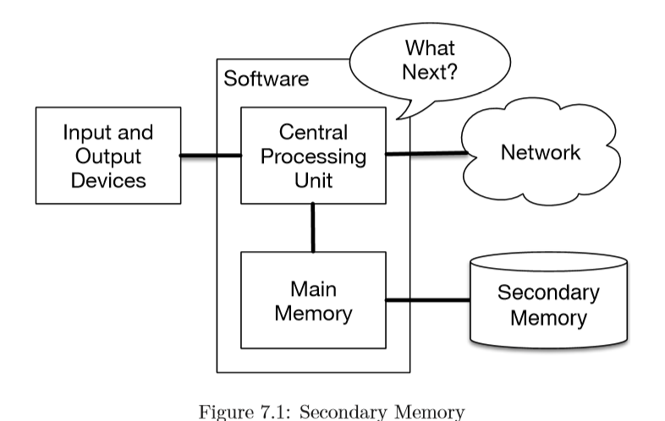
1.Files

Slide 6
Create a file
In Jupiter note book open a text file and write half page documents related to your profile and save it with name say profile.txt

Slide 7
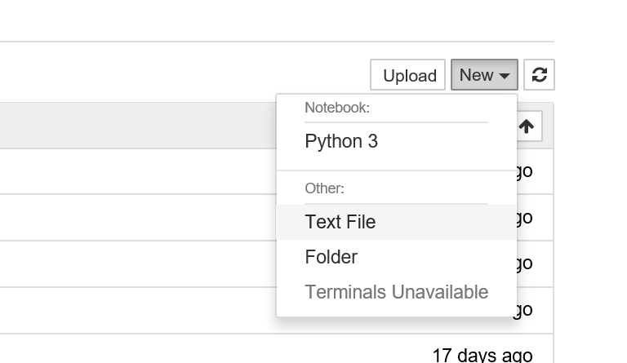

Slide 8
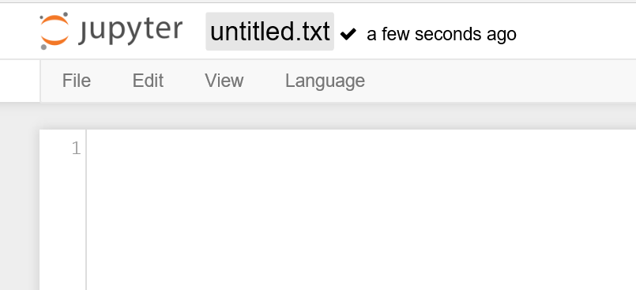

Slide 9
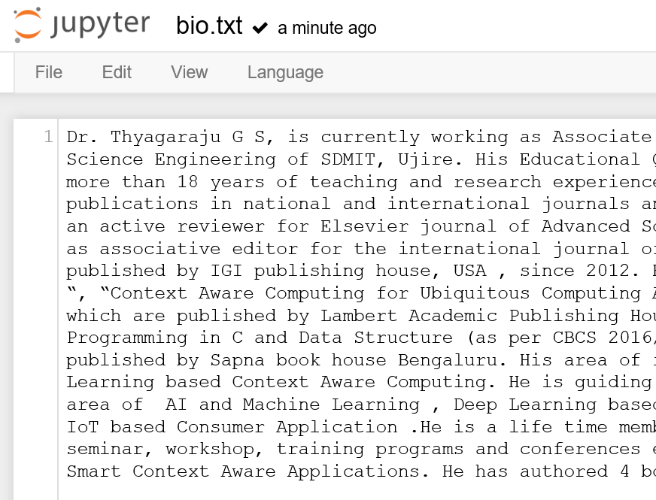

Slide 10
Open a file
f = open("bio.txt")
print(f)

Slide 11
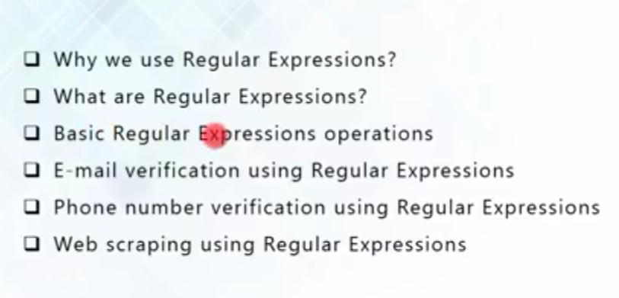

Slide 12
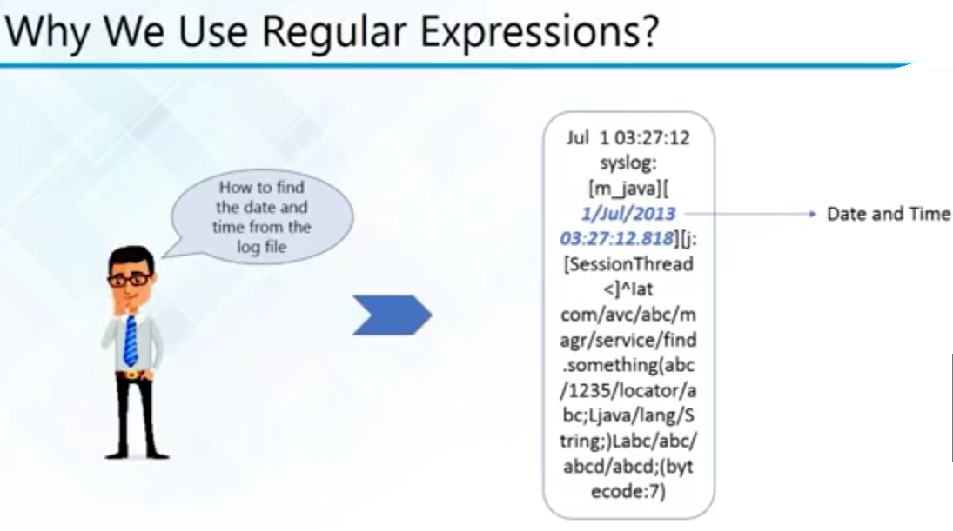

Slide 13
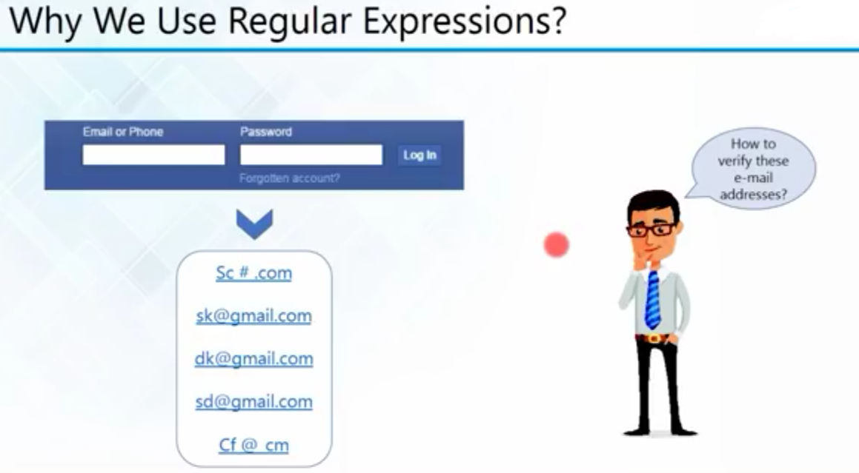

Slide 14
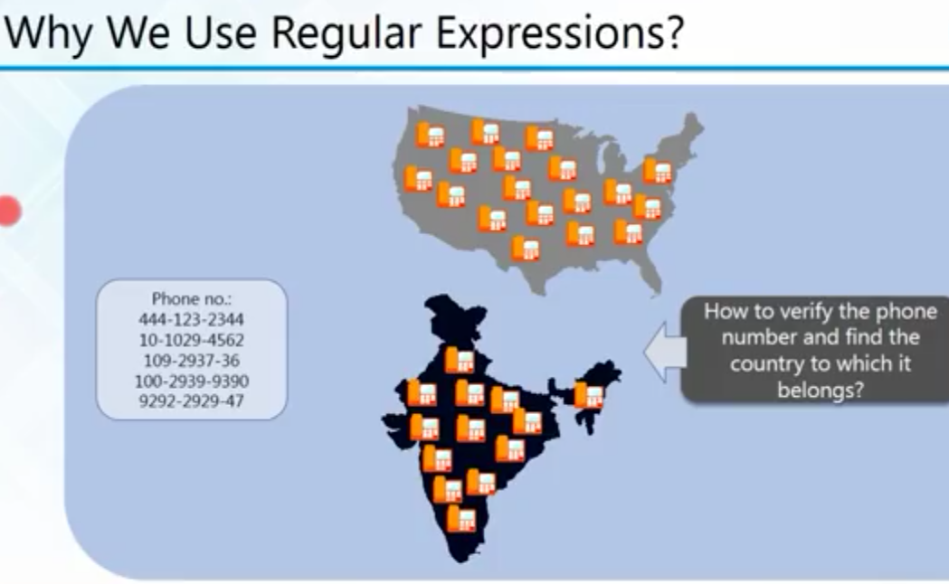

Slide 15
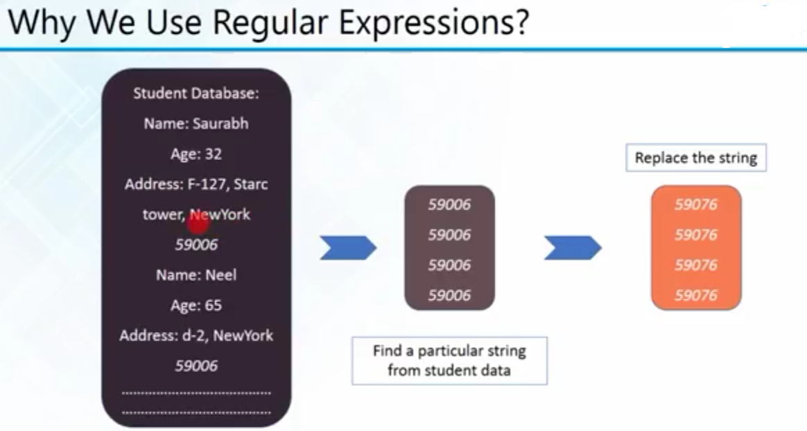

Slide 16
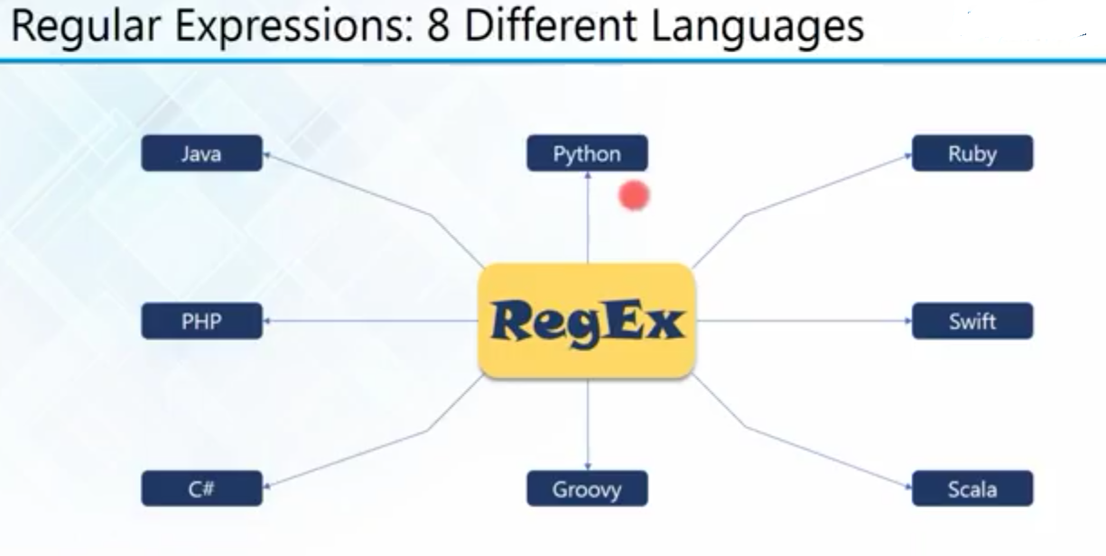

Slide 17
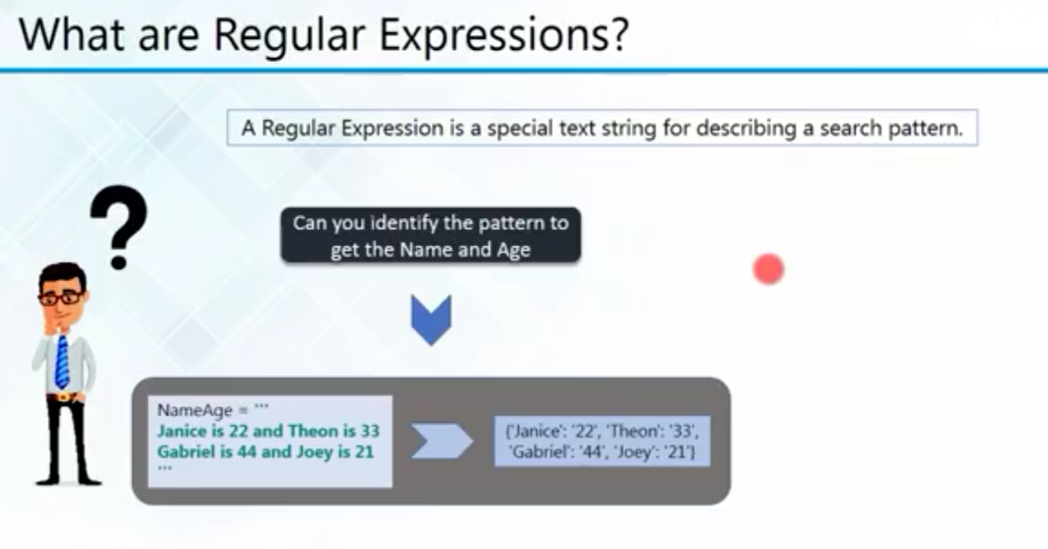

Slide 18
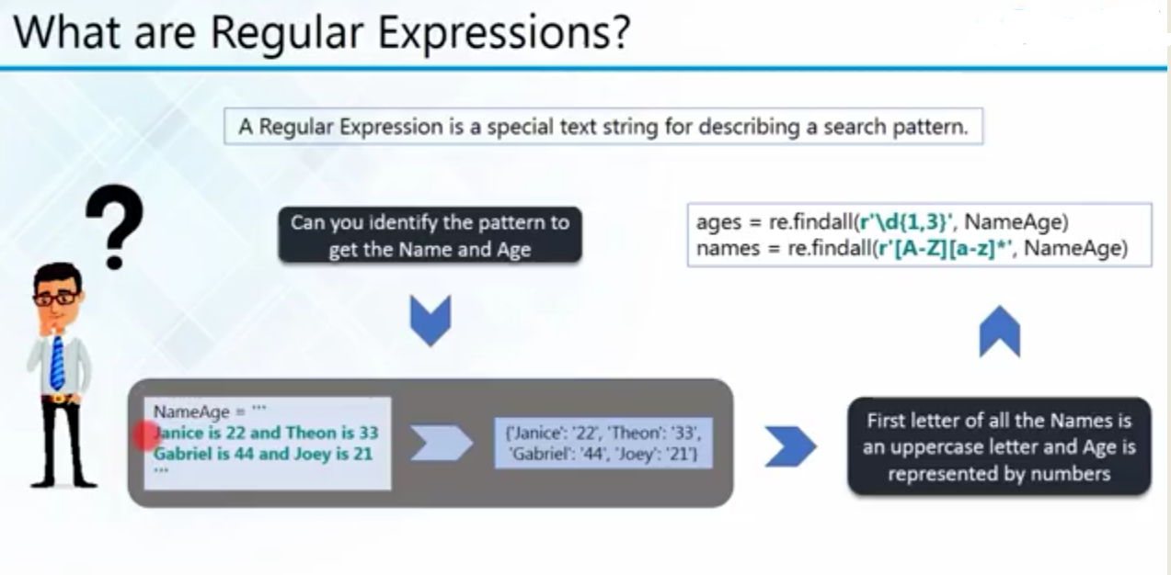

Slide 19
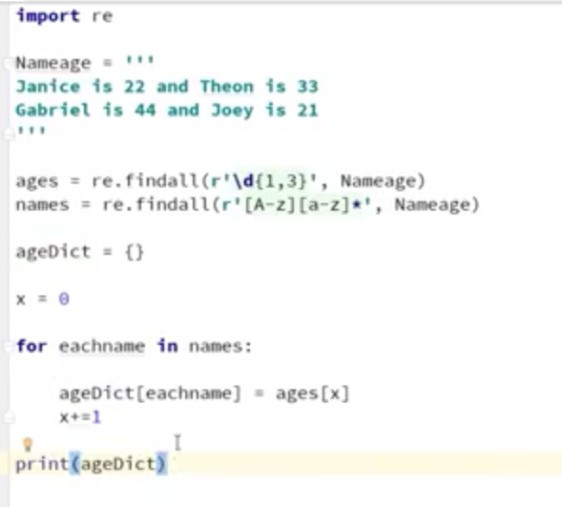

Slide 20
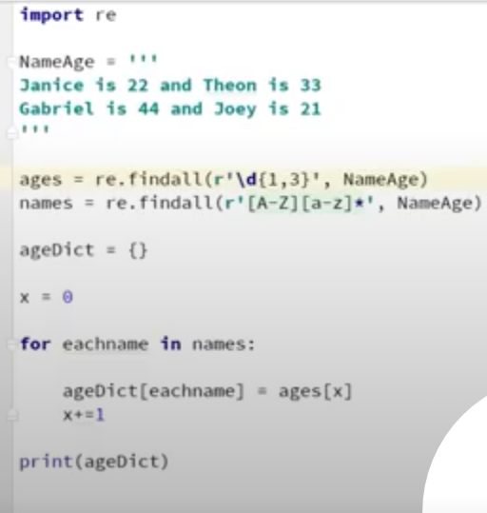

Slide 21
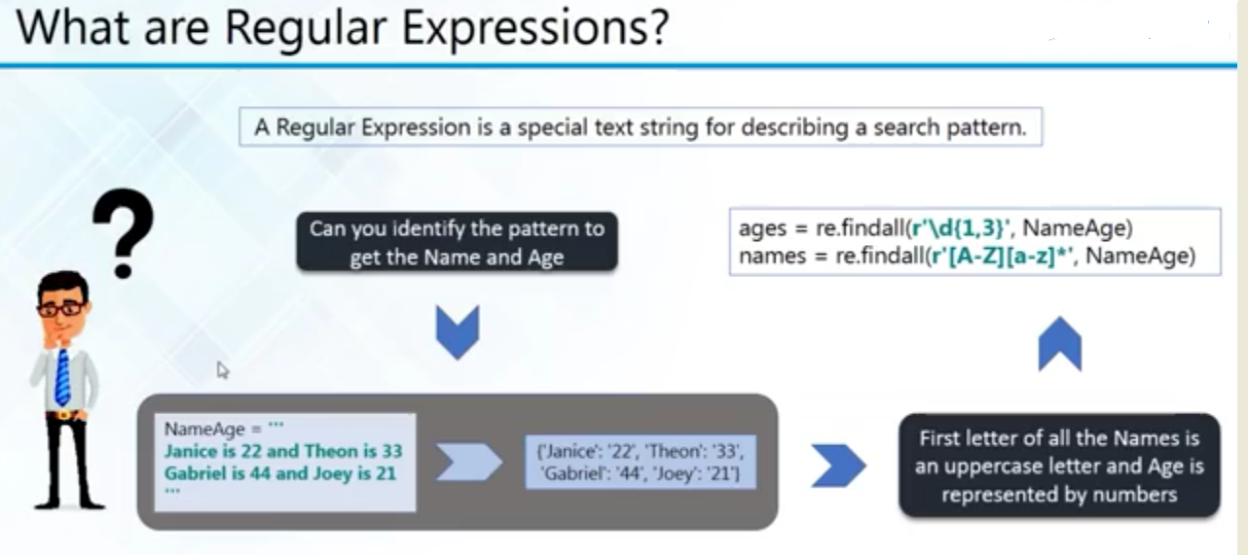

Slide 22
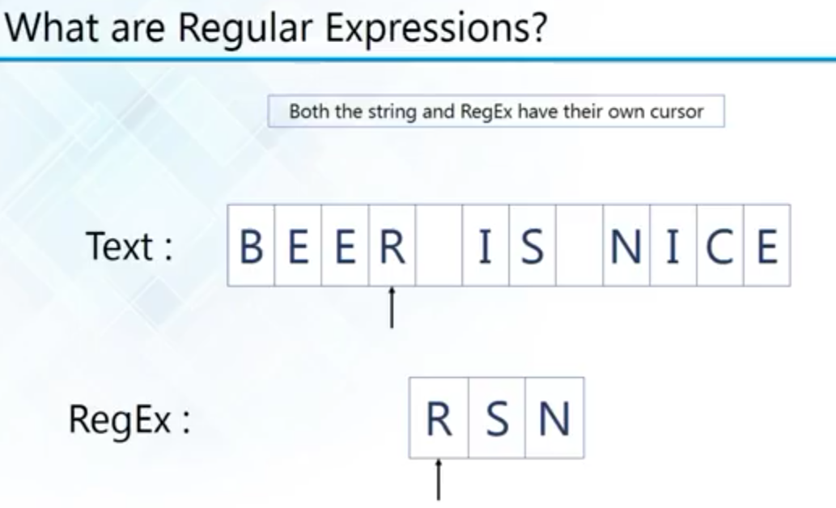

Slide 23
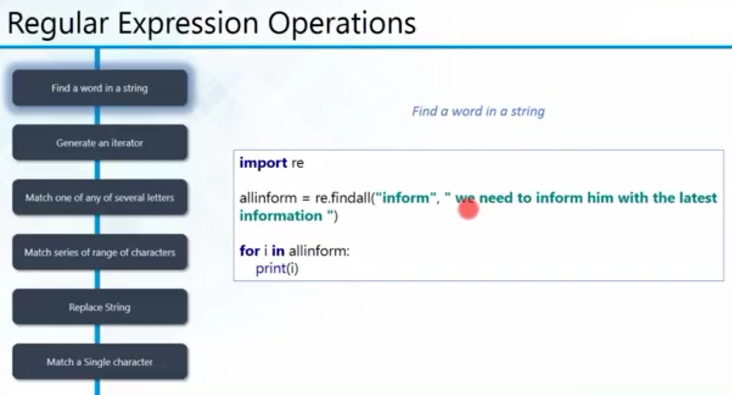

Slide 24
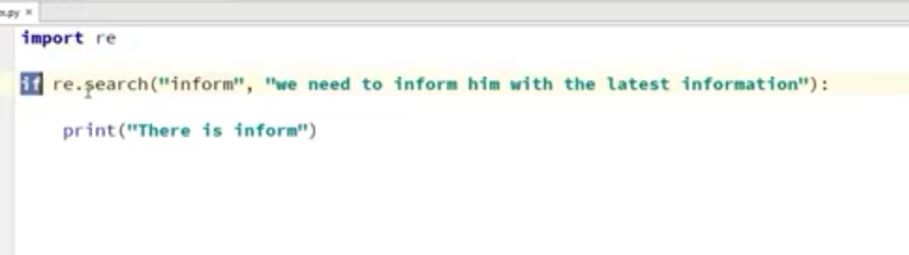

Slide 25
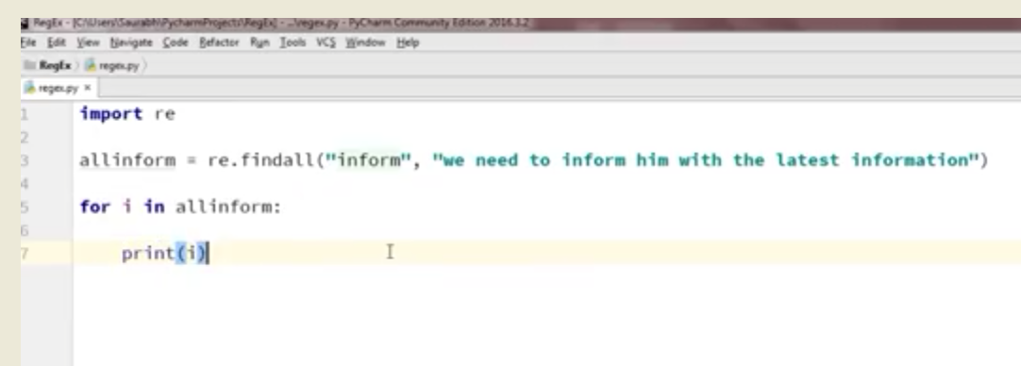

Slide 26
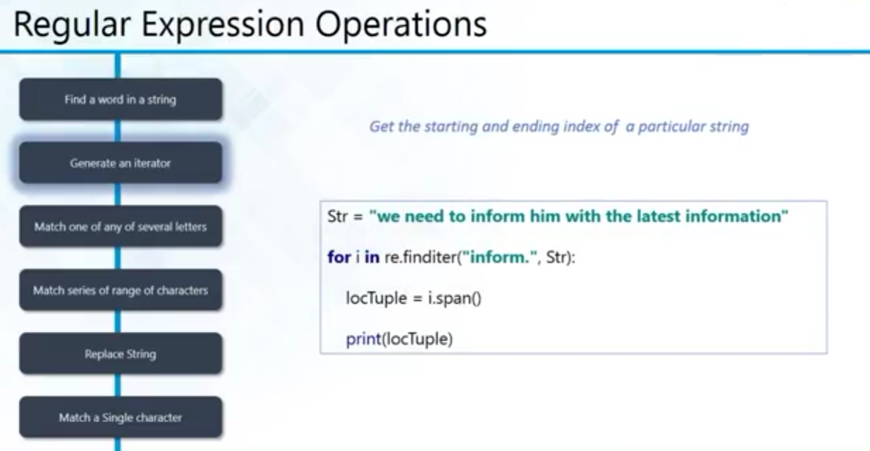

Slide 27
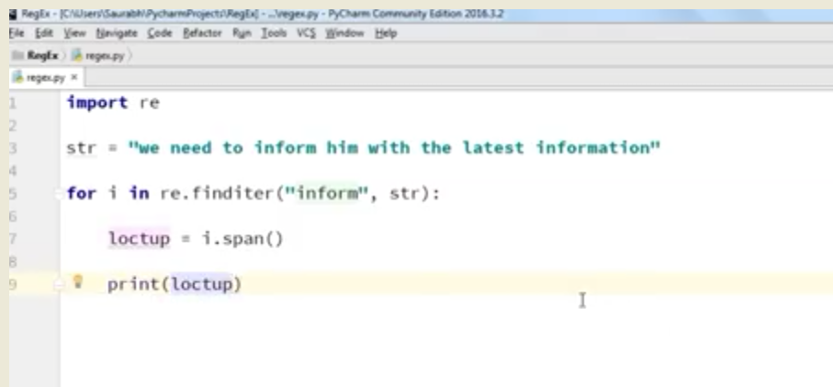

Slide 28
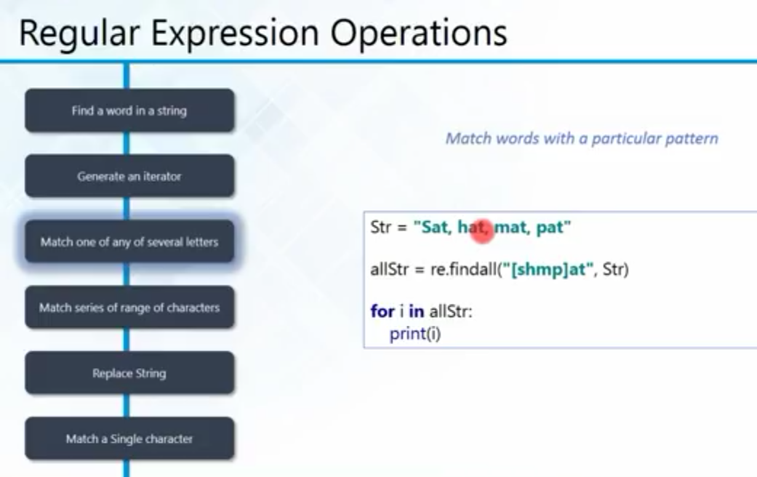

Slide 29
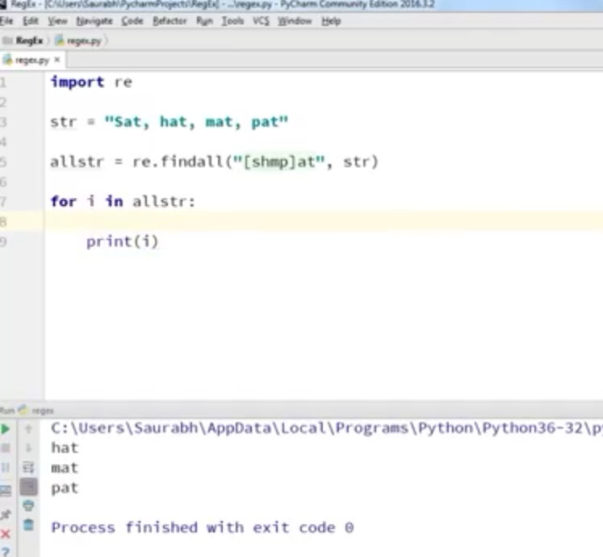

Slide 30
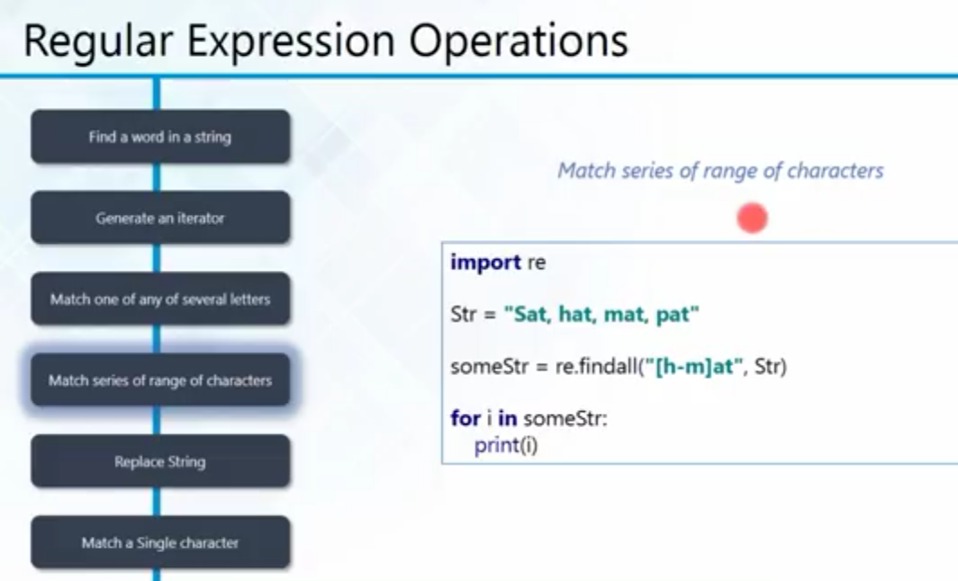

Slide 31
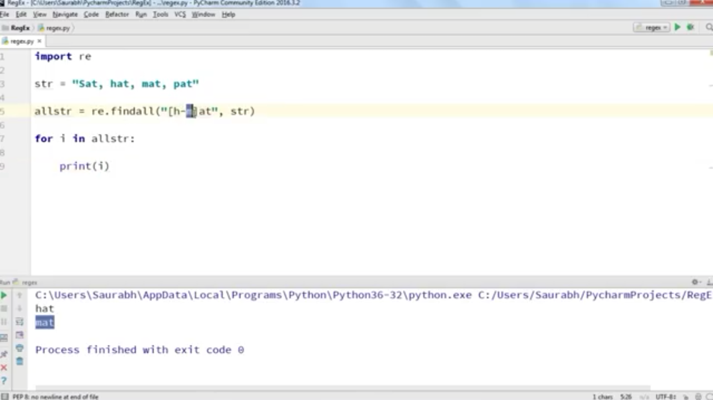

Slide 32
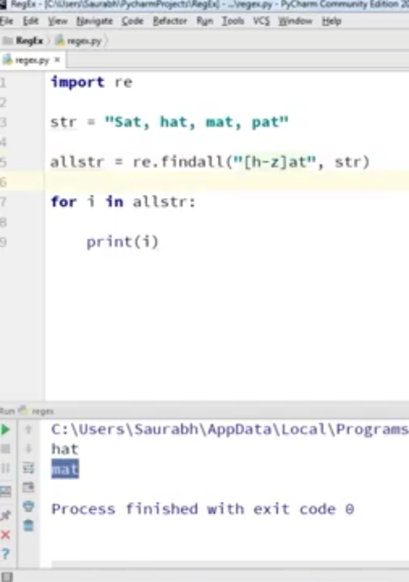

Slide 33
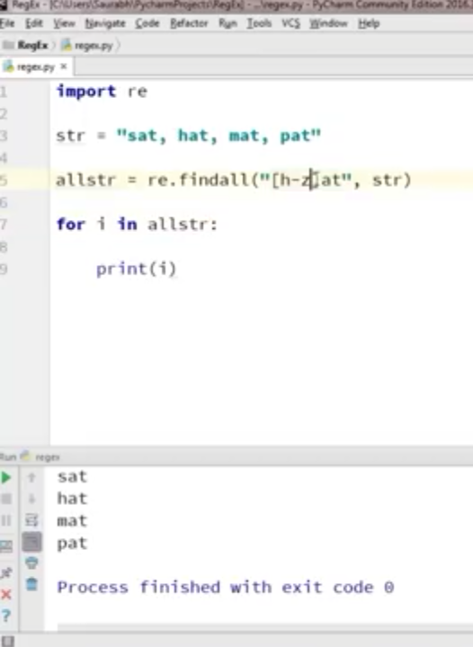

Slide 34
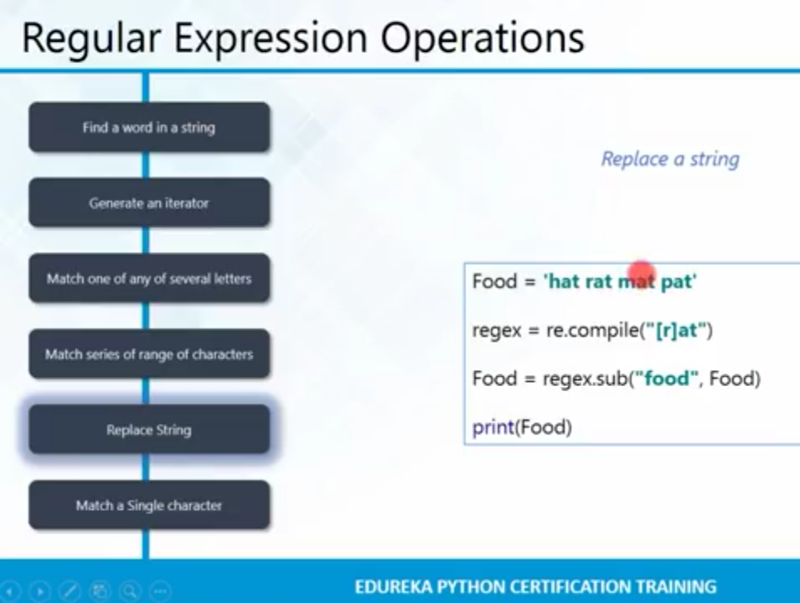

Slide 35
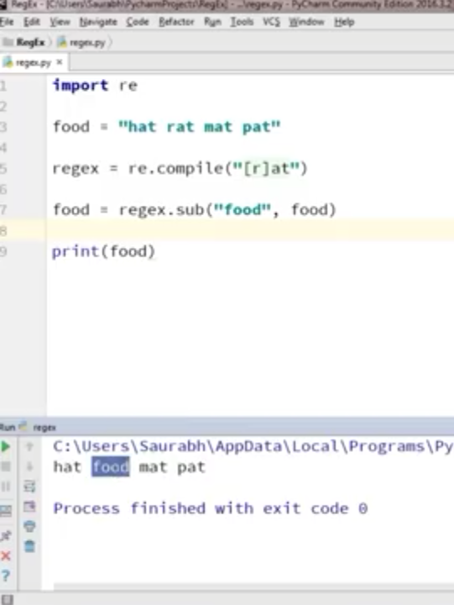

Slide 36
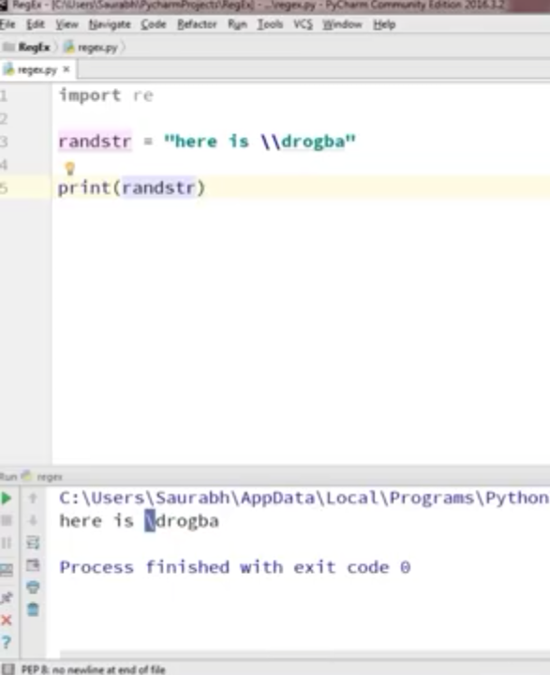

Slide 37
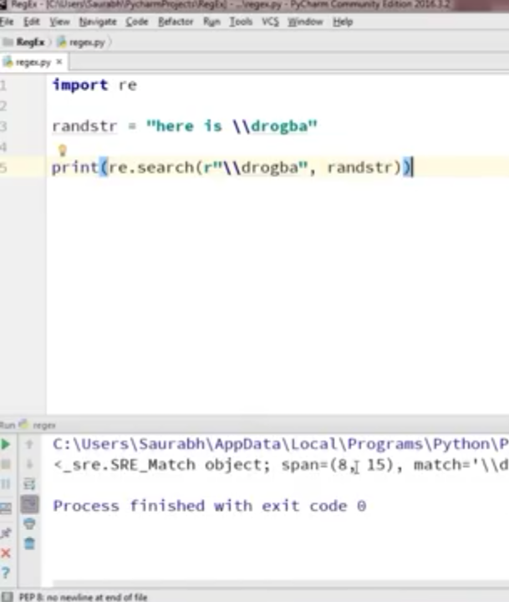

Slide 38
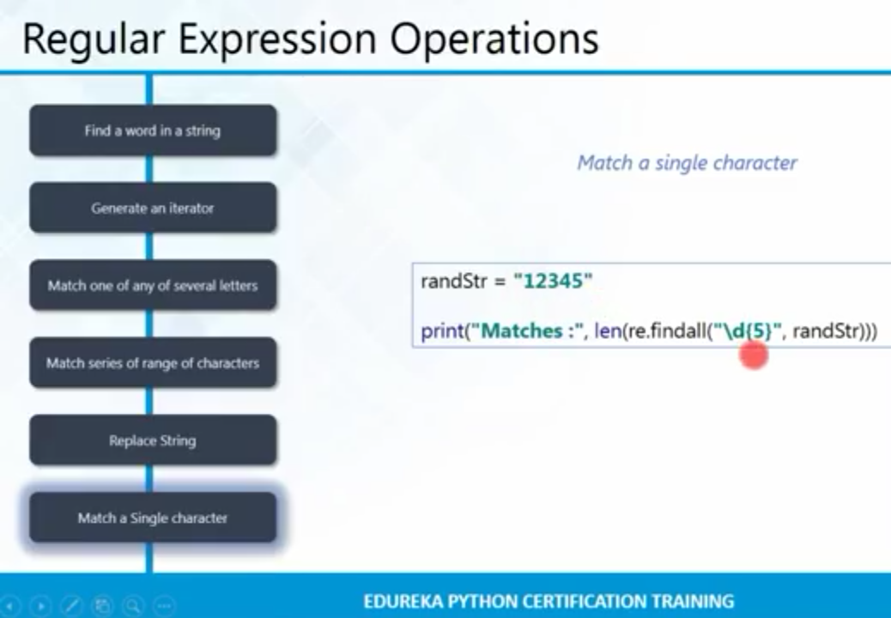

Slide 39
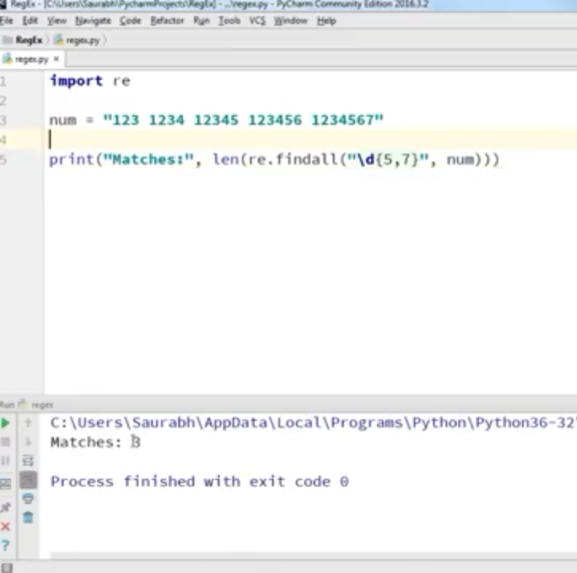

Slide 40
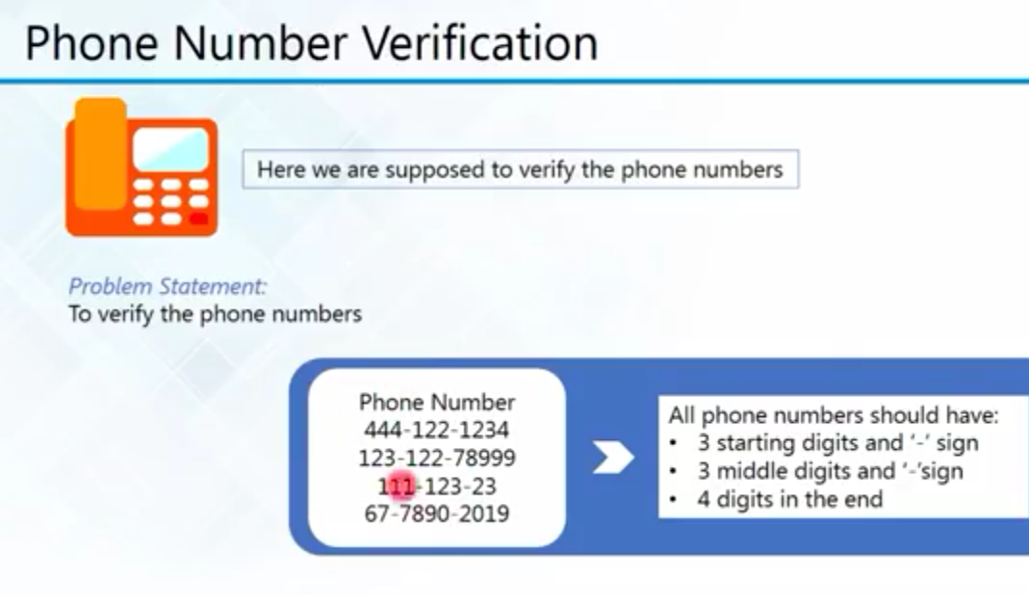

Slide 41
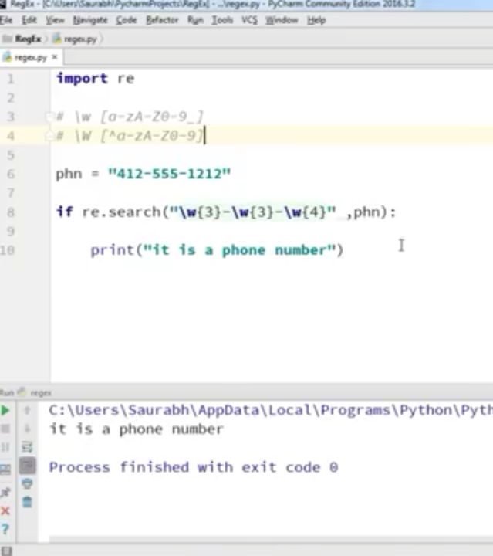

Slide 42
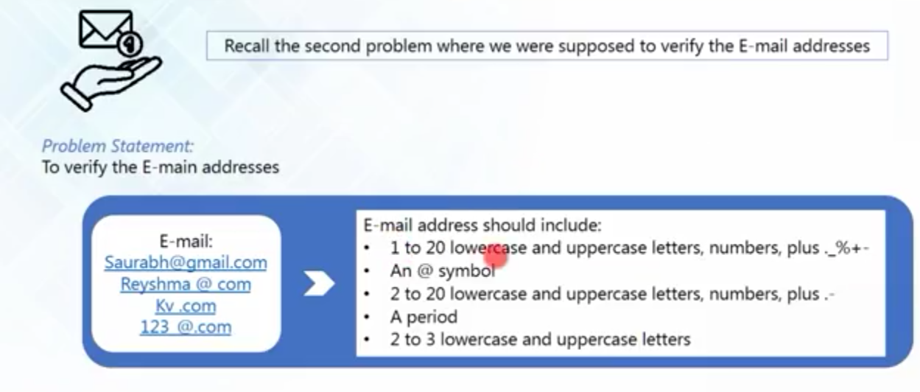
E- Mail Verification

Slide 43
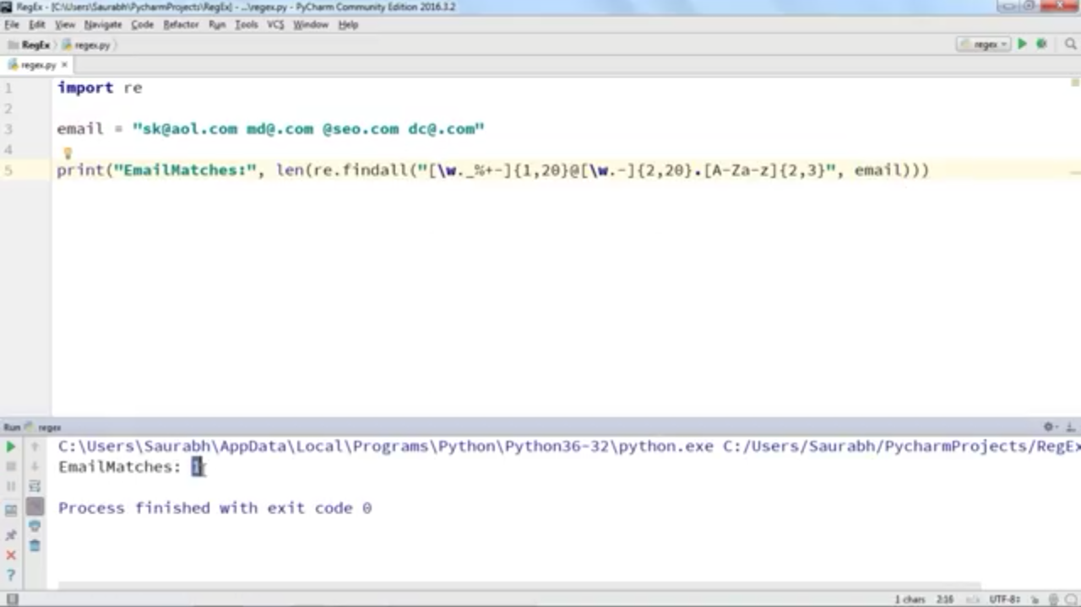

Slide 44
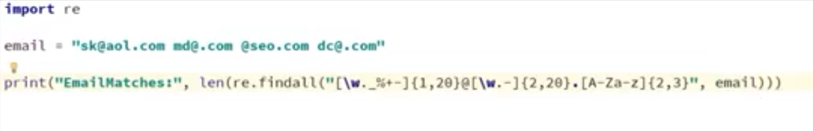

Slide 45
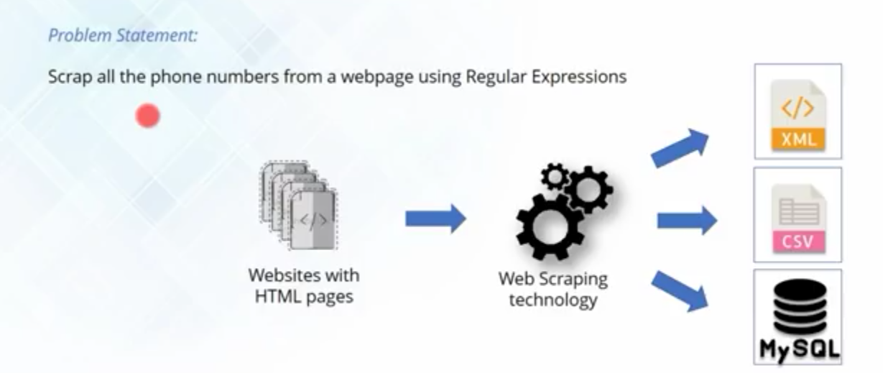
Web Scraping

Slide 46
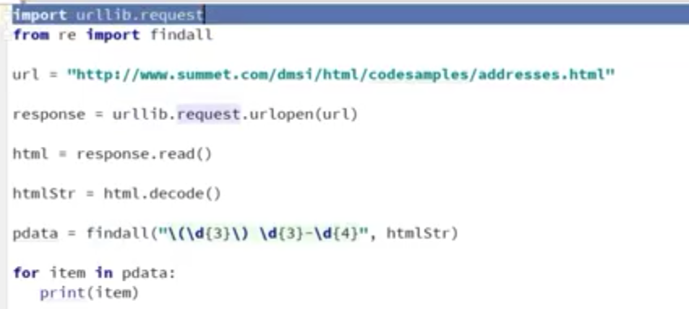

Slide 47
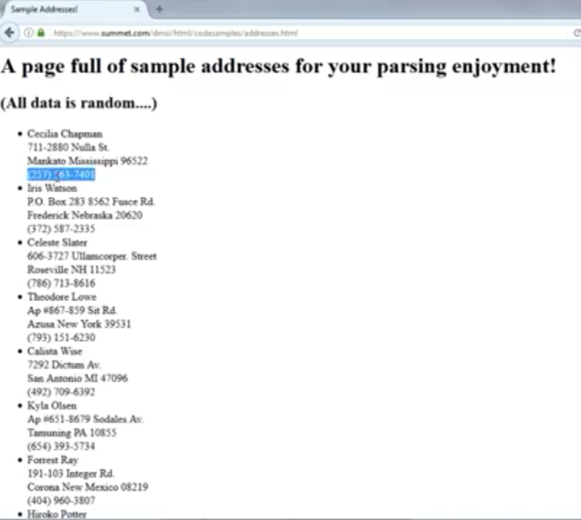

Slide 48
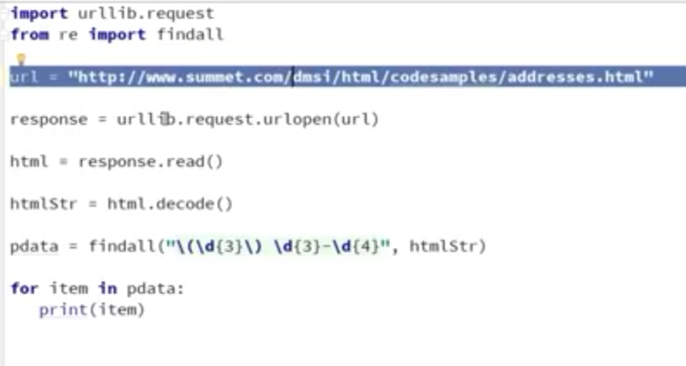

Slide 49
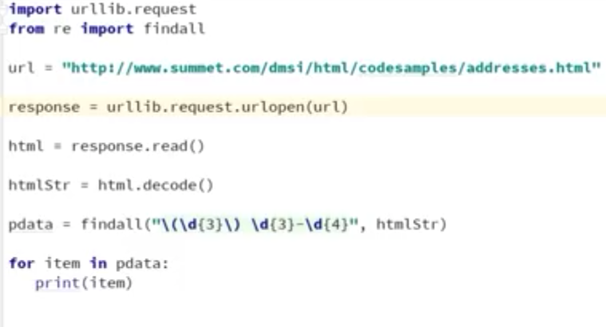

Slide 50
